Slide 1
First Considerations
The proton spectrum consists of two signal groups. There are two chemically distinguishable protons whose number is not yet known, i.e. n H_{a} and m H_{b}.
We need the values of n and m.
The molecular formula results in one double bond equivalent.
The structural fragments H-Cl, H-H and H₂O are not possible. In each case we would end in a mixture of at least two components.
n H_{a}
The structural fragment –OH is not excluded.
m H_{b}

Slide 2

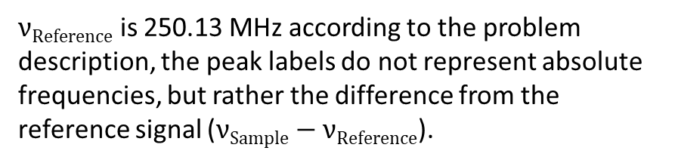
Chemical shifts
In order to estimate the chemical shifts more accurately than is possible just by looking at the scale below the spectrum, we need the peak labels given in Hz together with the well-known formula
$$δ=\frac{νSample−νReference}{νReference}$$
$νReference$ is 250.13 MHz according to the problem description, the peak labels do not represent absolute frequencies, but rather the difference from the reference signal ($νSample−νReference$).

Slide 3


Chemical shifts
$$δa=\frac{\left(740.44 Hz+718.37 Hz\right)}{2∗250.13 MHz}=2.92 ppm$$
$$δb=\frac{\left(312.89 Hz+298.13 Hz\right)}{2∗250.13 MHz}=1.22 ppm$$
2.92 ppm
1.22 ppm
Please remember: ppm is not a unit of measurement, but the dimensionless number, 10⁻⁶, which is used like a unit of measurement.

Slide 4
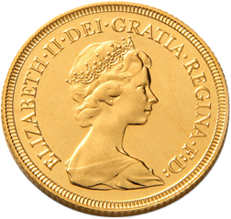
Integration
The area of both signal groups contains an unknown coefficient of proportionality, which is identical for each signal group.
A possible coefficient of proportionality for example might be
pieces of gold/proton
Let's measure our integrals using gold pieces.
And how do we extract the coefficient of proportionality?
2.92 ppm
1.22 ppm
61 pieces of gold
92 pieces of gold

Slide 5
Integration
The molecular formula (C₃H₅ClO) includes 5 protons.
The height of both integrals together is 153 pieces of gold.
153 gold pieces ≙ 5 protons
1 gold piece ≙ 0.033 protons
61 gold pieces ≙ 1.99 protons
92 gold pieces ≙ 3.01 protons
And how do we extract the coefficient of proportionality?
2.92 ppm
1.22 ppm
3H
2H
61 pieces of gold
92 pieces of gold

Slide 6
Struktural fragments
Taking into account the available atoms, only carbon is able to have thee hydrogens attached.
For two equivalent protons there are two choices: -CH₂- or H₂O.
But we already excluded H₂O by other reasons.
H
H
C
C
H
H
H
2.92 ppm
A =CH₂ group is excluded because of the chemical shift. Protons attached to sp²-hybridized carbon atoms show a chemical shift of about 5 ...7 ppm.
1.22 ppm
3H
2H

Slide 7
Struktural fragments
A short inventory
molecular formula - C₃H₅ClO
already known fragments - C₂H₅
missing atoms - C, Cl, O
H
H
C
what else is missing - 1 double
bond
equivalent
C
H
H
H
There is only one possibility for the missing pieces.
2.92 ppm
1.22 ppm
O
Cl
C
3H
2H

Slide 8
Struktural fragments
H
H
H
We have two possibilities to put the four fragments together.
C
C
H
Cl
C
Which one is correct?
H
H
H
C
O
O
H
H
C
H
H
C
C
H
Cl
C
H
2.92 ppm
1.22 ppm
O
H
H
Cl
C
3H
2H

Slide 9
Struktural fragments
H
H
H
H
H
H
C
C
C
C
H
H
Cl
C
Cl
C
H
H
H
H
C
O
O
O
H
H
C
H
H
C
C
O
H
Cl
H
H
C
H
2.92 ppm
C
1.22 ppm
C
O
Cl
H
H
C
H
Cl
C
3H
2H
H
H

Slide 10
Final structures
H
H
H
First, let us try to apply Shoolery‘s rule for the methylene protons.
C
C
H
Cl
C
H
base value 0.23
-Cl 2.53
-COR 1.70
sum 4.43
O
base value 0.23
-CH₃ 0.47
-COR 1.70
sum 2.40
O
H
H
2.92 ppm
C
1.22 ppm
C
Cl
C
H
3H
2H
H
H

Slide 11
Final structures
H
H
H
Furthermore, in this compound the protons of the CH₂ group are 4 bonds away from the protons of the CH₃ group. Instead of multiplets, we would see two singlets.
C
C
H
Cl
C
H
base value 0.23
-Cl 2.53
-COR 1.70
sum 4.43
O
O
H
H
2.92 ppm
C
1.22 ppm
1.22 ppm
C
Cl
C
H
3H
2H
2.92 ppm
H
H

Slide 12
Finale structure
O
H
H
C
1.22 ppm
C
Cl
C
H
2.92 ppm
H
H
O
H
H
In this structure the protons of the methyl group at 1.22 ppm are three bonds away from the two equivalent protons of the methylene group at 2.92 ppm and appear according to the n+1 rule as a triplet in the intensity ratio 1 : 2 : 1.
2.92 ppm
C
1.22 ppm
1.22 ppm
C
Cl
C
H
3H
2H
2.92 ppm
H
H

Slide 13
Finale structure
O
H
H
C
1.22 ppm
C
Cl
C
H
2.92 ppm
H
H
On the other hand, the protons of the methylene group at 2.92 ppm are also three bonds away from the three equivalent protons of the methyl group at 1.22 ppm. According to the n+1 rule, this results in a quartet for the protons of the methylene group with the intensity ratio 1 : 3 : 3 : 1.
2.92 ppm
1.22 ppm
3H
2H

Slide 14

Finale structure
$$J=\frac{740.44 Hz−718.37 Hz}{3}=7.36 Hz$$
$$J=305.53 Hz−298.13 Hz=7.40 Hz$$
O
H
H
C
1.22 ppm
C
Cl
C
H
2.92 ppm
H
H
7.37 Hz
(Mittelung über beide Multipletts)
2.92 ppm
1.22 ppm
The coupling constant might either be read directly from two neighbouring lines or averaged over a whole multiplet in the interest of better accuracy.
3H
2H

Slide 15
Contributions
Spectrometer time
TU Munich
Measurements
Rainer Haeßner
Discussions and native English language support
Compilation
Alan Kenwright
Rainer Haeßner
More exercises …

