Slide 1
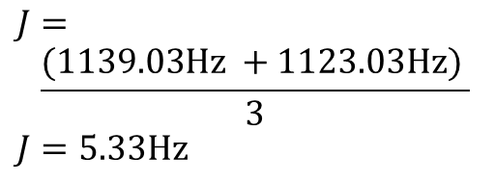
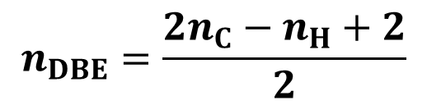
There is no double bond equivalent.
C₄H₁₀O₂ recorded in CDCl₃
Step-by-step-solution
The chemical shifts are not particularly important in this example. An estimation is sufficient.
There are only two multipletts, i.e. they can only be "pure" multiplets – in thuis case a doublet and a quartet.
The coupling constant is 5.33 Hz.
$$n_{DBE}=\frac{{2n}_{C}−n_{H}+2}{2}$$
Hz
311.25
305.91
1128.36
1133.69
Hz
$$J=$$
$$\frac{(1139.03Hz +1123.03Hz) }{3}$$
$$J=5.33Hz$$
1139.03
1123.03
5.33 Hz
(d)
5.33 Hz
(q)
1.29
1.25
1.21
4.5 ppm
4.55
4.50
3.3 ppm
1.2 ppm
Inte-
gral
1.00
6.16
3.04
4.5
4.0
3.5
3.0
¹H
2.5
2.0
1.5
ppm

Slide 2
There is no double bond equivalent.
C₄H₁₀O₂ recorded in CDCl₃
Integration is simple, the proportionality factor between the measured integral (in arbitrary units) and the proton number is just 1.
5.33 Hz
(d)
5.33 Hz
(q)
4.5 ppm
3.3 ppm
1.2 ppm
Inte-
gral
1H
6H
3H
1.00
6.16
3.04
4.5
4.0
3.5
3.0
¹H
2.5
2.0
1.5
ppm

Slide 3
C₄H₁₀O₂
There is no double bond equivalent.
C₄H₁₀O₂ recorded in CDCl₃
C₄H₁₀O₂
Let us first assume that all three signal groups originate from CH_{n} fragments. The reason why OH is out of question follows in a few steps.
Then we would have a CH group at 4.5 ppm and a CH₃ group at 1.2 ppm.
5.33 Hz
(d)
H
C
5.33 Hz
(q)
3
CH
4.5 ppm
3.3 ppm
1.2 ppm
1H
6H
3H
4.5
4.0
3.5
3.0
¹H
2.5
2.0
1.5
ppm

Slide 4
If the carbon atoms of the two fragments are joined together, the coupling patterns of both multiplets can be well explained.
C₄H₁₀O₂
In the case of CH, of course, two free valences are missing.
A coupling constant of 5.33 Hz is somewhat small for vicinal coupling. 7 Hz would be ideal. On the other hand, a wide-range coupling across four single bonds would be much smaller, about 0.5 Hz.
Let us now replace CH with OH on a trial basis.
5.33 Hz
H
C
CH
3
5.33 Hz
(d)
H
C
5.33 Hz
(q)
3
CH
4.5 ppm
3.3 ppm
1.2 ppm
1H
6H
3H
4.5
4.0
3.5
3.0
¹H
2.5
2.0
1.5
ppm

Slide 5
This would give us methanol. Further connections are not possible, but the part of the molecule responsible for the singlet at approx. 3.3 ppm still has to be connected somehow.
C₄H₁₀O₂
Lets return to CH₃–CH<.
H
C
OH
3
5.33 Hz
(d)
5.33 Hz
(q)
4.5 ppm
3.3 ppm
1.2 ppm
1H
6H
3H
4.5
4.0
3.5
3.0
¹H
2.5
2.0
1.5
ppm

Slide 6
A singlet with 6 protons might be due to two equivalent CH₃ or three equivalent CH₂ groups.
C₄H₁₀O₂
Two out of a total of four C atoms are already assigned. Three more carbon atoms are impossible. The signal at 3.3 ppm comes from two equivalent methyl groups.
H
C
3
The methyl groups cannot be directly attached to the CH group. If they were directly attached, we would see a doublet at 3.8 ppm.
X
5.33 Hz
H
C
CH
3
1.2 ppm
4.5 ppm
X
H
C
3
4.5 ppm
3.3 ppm
1.2 ppm
1H
6H
3H
4.5
4.0
3.5
3.0
¹H
2.5
2.0
1.5
ppm

Slide 7
A short inventory is sufficient for a complete structural elucidation.
C₄H₁₀O₂
molecular formula : C₄H₁₀O₂
known fragments : C₄H₁₀
missing : O₂
H
C
3
H
C
3
This results in a single option for the final structure.
O
5.33 Hz
H
C
CH
3
1.2 ppm
4.5 ppm
O
H
C
H
C
3
3
3.3 ppm
3.3 ppm
1H
6H
3H
4.5
4.0
3.5
3.0
¹H
2.5
2.0
1.5
ppm

Slide 8
Contributions
Spectrometer time
TU Munich
Measurements
Rainer Haeßner
Discussions and native English language support
Compilation
Alan Kenwright
Rainer Haeßner
More exercises …

